Slide 1

Microarray data analysis – Related to Covid-19 high-dimensional immune profiling of severe COVID-19 patients reveals distinct patterns of immunosuppression and immunoactivation

Slide 2
*Organism : Homo Sapiens
*Attributes(Samples): 195
*Records:10

Slide 3
To delineate the in situ immune responses to SARS-CoV-2 viral infection, we performed comprehensive immune profiling in COVID-19 decedents. In this study, we described the immune microenvironment of COVID-19 patients through transcriptome sequencing.
This dataset contains expression from localized sampling within 8 SARS-CoV-2 infected patient FFPE samples collected during rapid autopsy. Up to 12 segments were collected within each patient sample. RNA Scope on serial sections was used to guide ROI selection, and ROI ISH staining by RNA Scope is noted in the sample annotations.

Slide 4
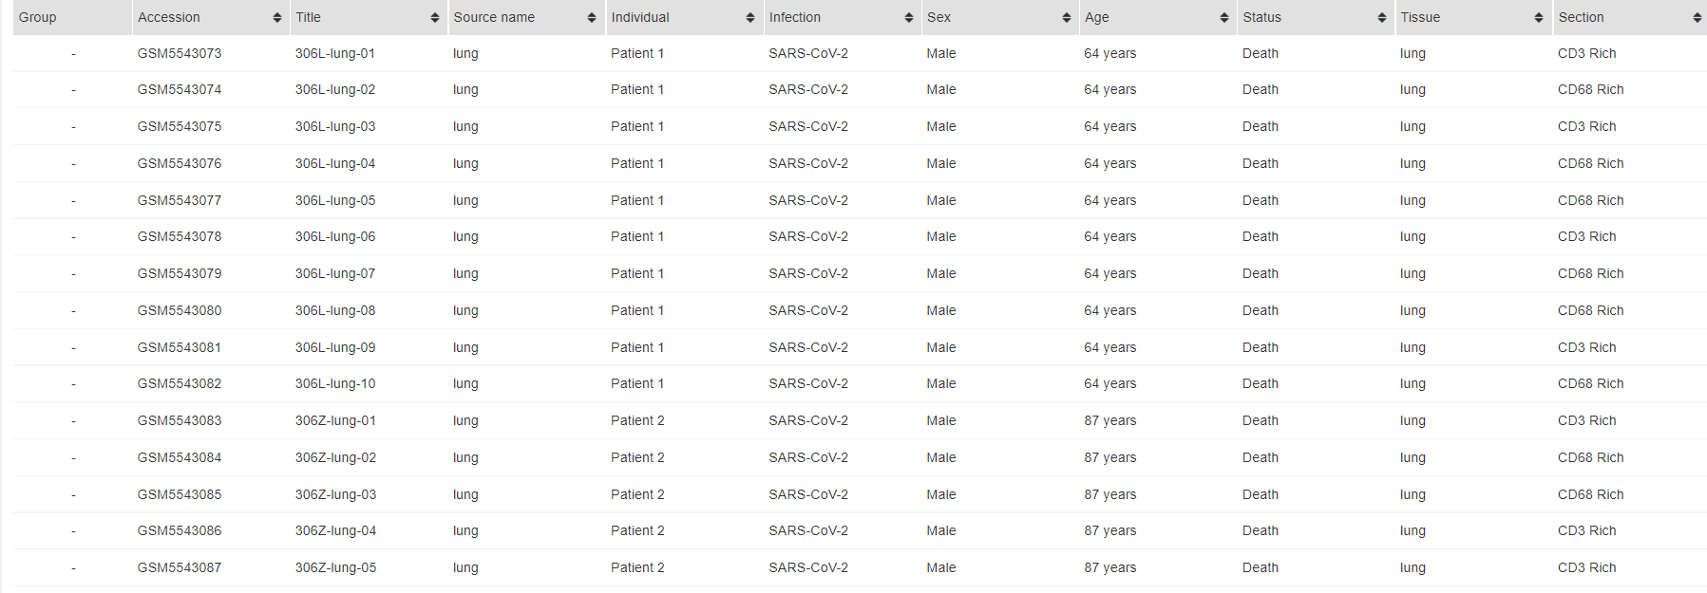
Overview of DataSet :

Slide 5
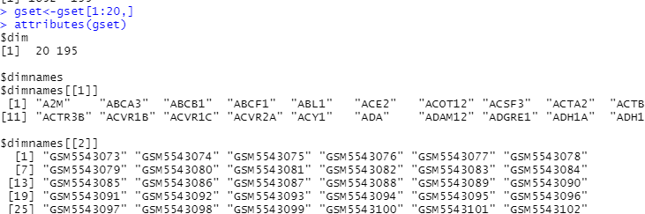
data for 20 gene expression

Slide 6
T- test :-
A t-test is a statistical test that is used to compare the means of two groups. It is often used in hypothesis testing to determine whether a process or treatment actually has an effect on the population of interest, or whether two groups are different from one another.
In t-test :
Test :contains gset from 1:4
Control : contains gset from 5:8

Slide 7
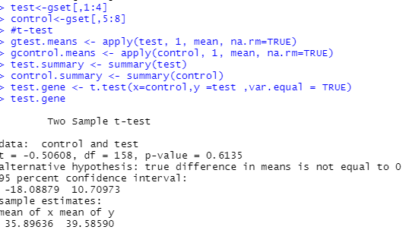
Two Sample –T-Test

Slide 8
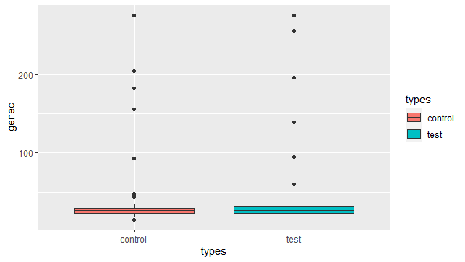
T-test visualization

Slide 9
Data Visualization:-
Data Visualization is the presentation of data in graphical format. It helps people understand the significance of data by summarizing and presenting huge amount of data in a simple and easy-to-understand format and helps communicate information clearly and effectively.

Slide 10
What is Boxplots?
We take the data that we want to make it boxing in plots.
For example : here we have (Group 1 of noninfected genes), also there are x-axis of genes and
y-axis of values, and finally main that contains the title of the overall boxplots.

Slide 11
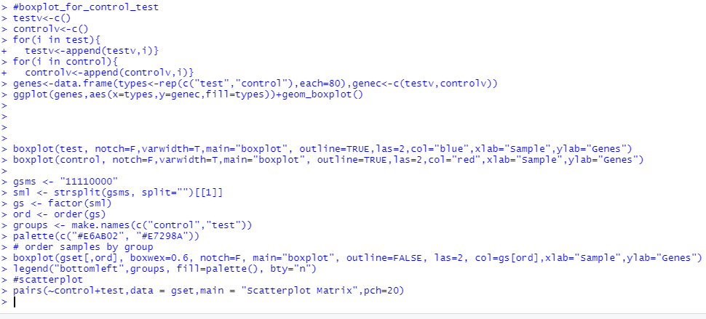
R Code Visualization

Slide 12
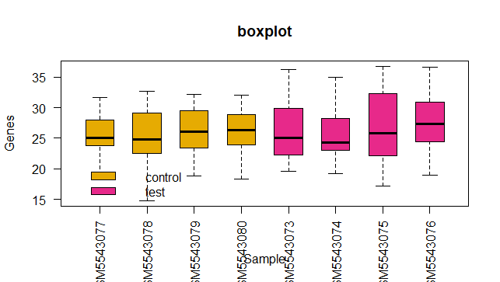

Slide 13
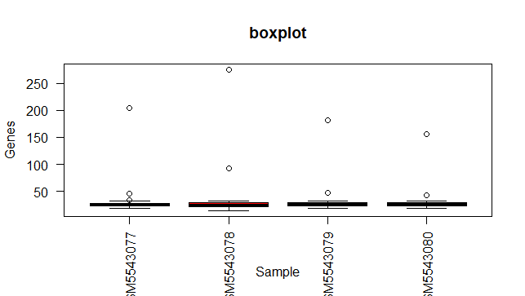

Slide 14
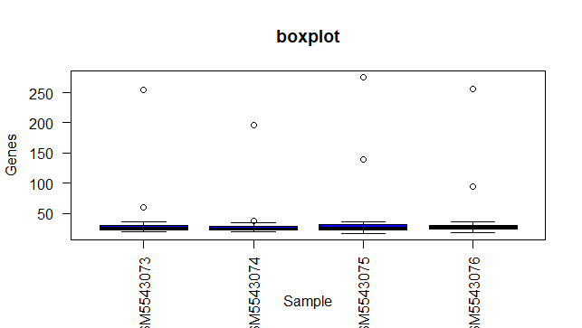

Slide 15
What is Scatter Plots?
Scatter Plots are used to plot data points on horizontal and a vertical axis in the attempt to show how one variable is affected by another .

Slide 16
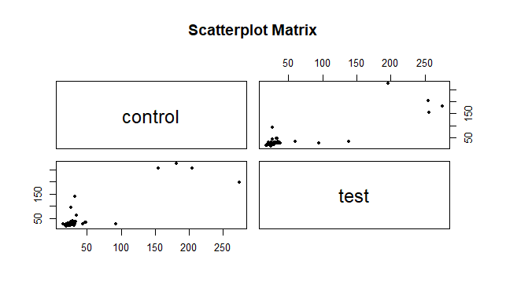

Slide 17
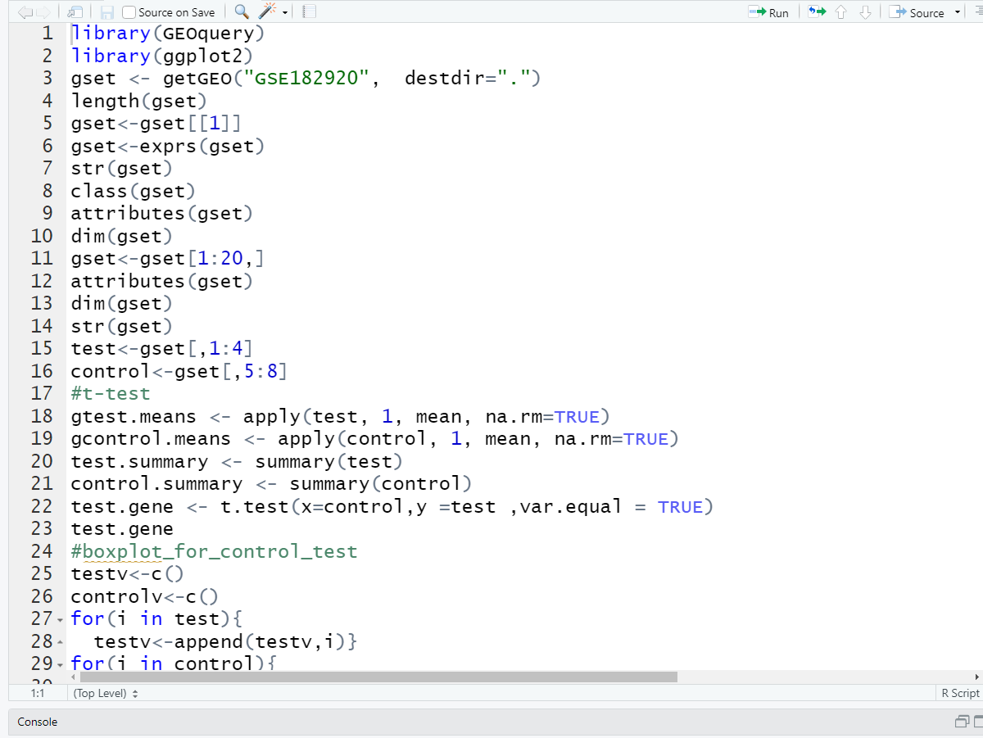
R-Code:-

Slide 18
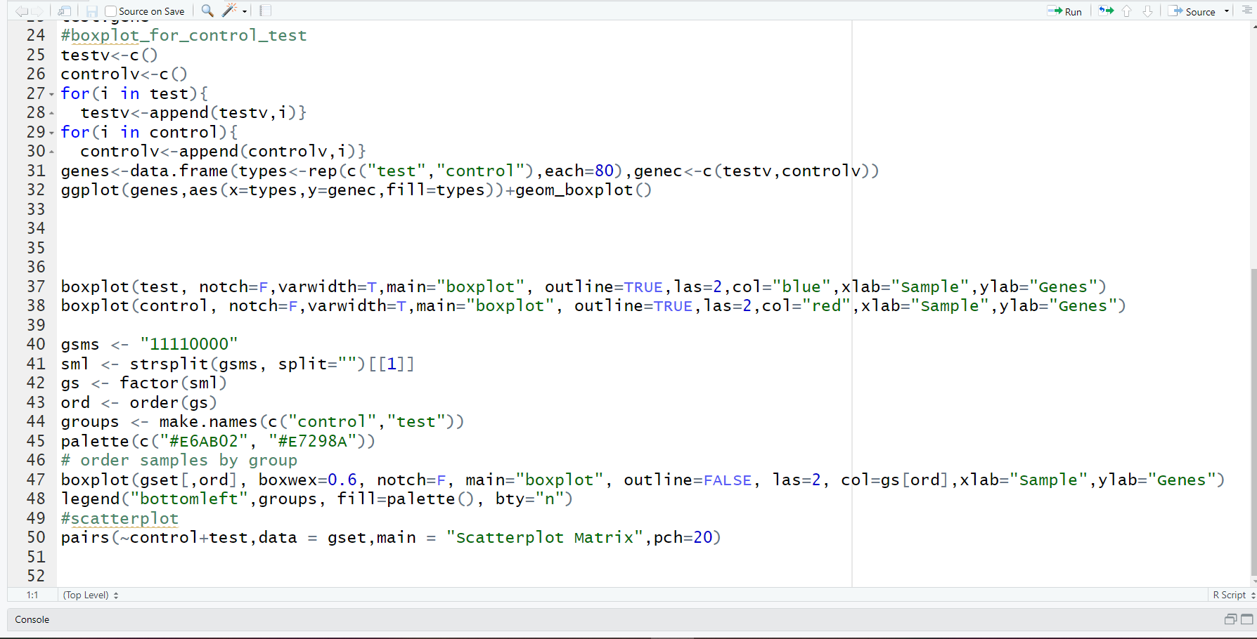

Slide 19
Data resources :-
We have used this link to get our analysis and work on it :-
https://www.ncbi.nlm.nih.gov/geo/query/acc.cgi?acc=GSE182920
Source code : https://ideone.com/WD2ndZ

Slide 20
1.خلود فاروق فواد- جروب 2 سكشن 1
2.جوليا عاطف نعيم جرجس- جروب 2 سكشن 1
3.ساره سامي جرجس سعد - جروب 2 سكشن 3
4. سلمي احمد نادي – جروب 2 سكشن 3
5. رواء صلاح رشيد – جروب 2 سكشن 2
6. رانيا عبدالمجيد اسماعيل – جروب 2 سكشن 2
Made by :

Slide 21
By supervision of :
Dr. Taysir Hassan
Introduction of Bioinformatics ( R Programming )

